Slide 1
Hi guy’s
Today we are going to know about war
What leads to war?
What is the impact of a war?
What can we do to prevent war?

Slide 2
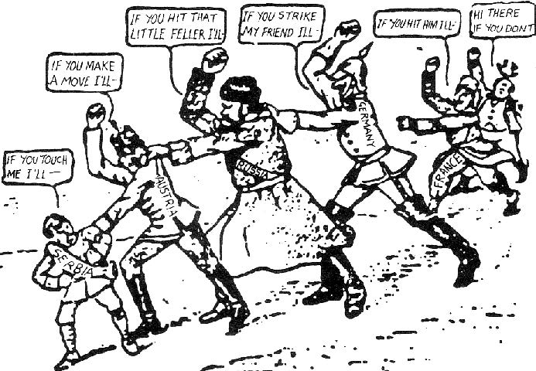
1.What leads to war?

Slide 3
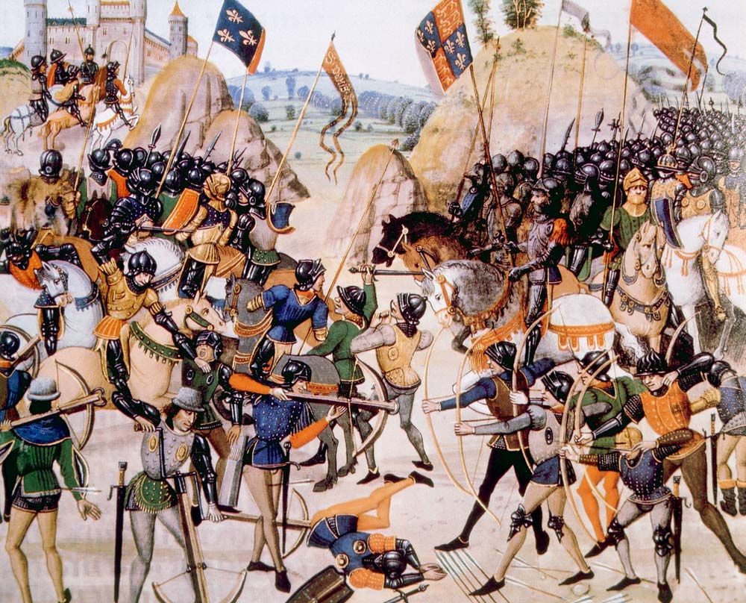
What leads to a war War is caused by many different reasons including competition over land religious conflicts and nationalism. Imperialism,racism,and slavery have also been causes of armed conflict

Slide 4
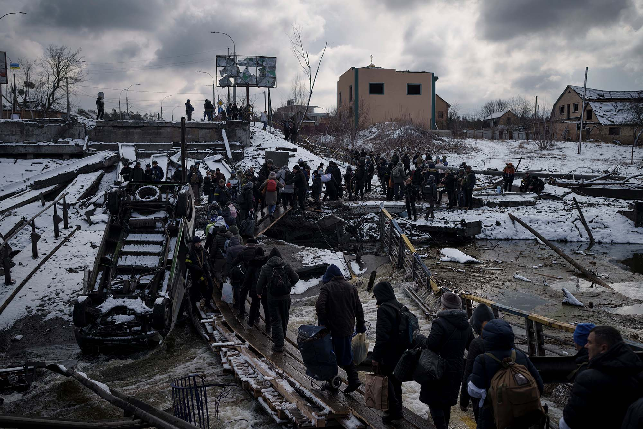
What is the impact of war

Slide 5
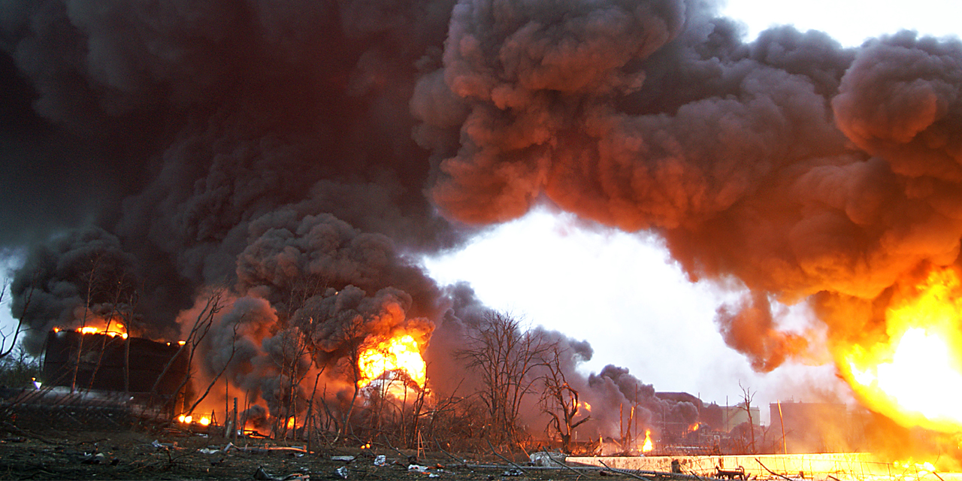
What is the impact of war? The negative impact that result from war include loss of life, destruction of cities and the environment, and human suffering . The human suffering includes injury,sexual,violence,malnutrition, ect….

Slide 6

What can we do to prvent war

Slide 7

What can we do to prevent war De-escalate the concept of enemy. Treat the other side with respect. Recognize that there is perception of injustice on both sides. Be prepared to forgive and ask for forgiveness. Refrain from belligerence.

